Slide 1
Dockerizing an App
Jeya Sundari Asokan

Slide 2
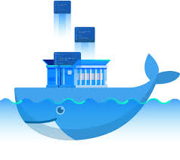
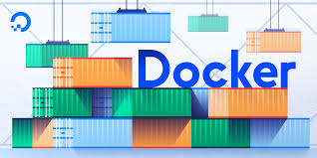
Agenda
Why Docker
What is Docker
When to use it
How to use it
Docker Architecture
Where can Docker work
Docker Commands
Demo

Slide 3
Why Docker
Docker containers can start or stop within seconds, which is faster than VMs.
Docker containers do not have high requirements on system resources. Thousands of Docker containers can run on the same host machine concurrently.
Docker containers allow users to obtain and update application images by performing operations like Git operations.
Docker containers can be automatically created and flexibly deployed using Dockerfiles, improving operational efficiency.
Except for running applications, Docker containers do not consume extra system resources. This ensures application performance and minimizes the system overhead.

Slide 4
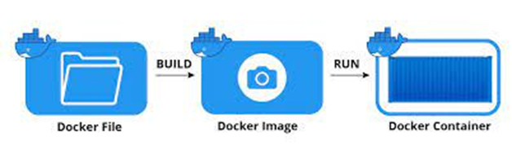
What is Docker
Docker is an open platform for developing, shipping, and running applications.
Docker enables you to separate your applications from your infrastructure so you can deliver software quickly.
With Docker, you can manage your infrastructure in the same ways you manage your applications.
By taking advantage of Docker’s methodologies for shipping, testing, and deploying code quickly, you can significantly reduce the delay between writing code and running it in production.

Slide 5
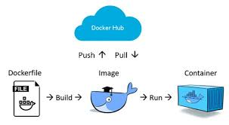
When to use Docker
Develop your application and its supporting components using containers.
The container becomes the unit for distributing and testing your application.
When you’re ready, deploy your application into your production environment, as a container or an orchestrated service. This works the same whether your production environment is a local data center, a cloud provider, or a hybrid of the two.

Slide 6
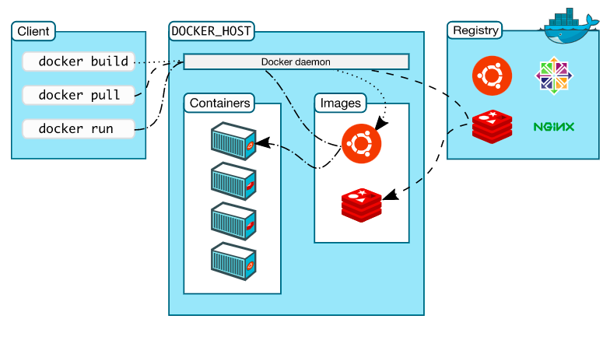
Docker Architecture

Slide 7
How to use Docker
Docker uses a client-server architecture.
The Docker client talks to the Docker daemon, which does the heavy lifting of building, running, and distributing your Docker containers.
The Docker client and daemon can run on the same system, or you can connect a Docker client to a remote Docker daemon.
The Docker client and daemon communicate using a REST API, over UNIX sockets or a network interface.
Another Docker client is Docker Compose, that lets you work with applications consisting of a set of containers.

Slide 8



Where can Docker work
Docker Desktop for Mac
Docker Desktop for Windows
Docker Desktop for Linux

Slide 9
Docker Commands
docker login
docker build
docker images
Log in to a Docker registry
Usage :
$ docker login [OPTIONS] [SERVER]
Refer here for options
Example:
$ docker login localhost:8080
Build an image from a Dockerfile
Usage :
$ docker build [OPTIONS] PATH | URL | -
Refer here for options
Example :
$ docker build -t simpleapi .
List images
Usage :
$ docker images [OPTIONS] [REPOSITORY[:TAG]]
Refer here for options
Example :
$ docker images
docker logout
docker tag
docker ps
Log out from a Docker registry
Usage :
$ docker logout [SERVER]
Example:
$ docker logout localhost:8080
Create a tag TARGET_IMAGE that refers to SOURCE_IMAGE
Usage :
$ docker tag SOURCE_IMAGE[:TAG] TARGET_IMAGE[:TAG]
Example :
$ docker tag simpleapi xxx23/simpleapi
List containers
Usage :
$ docker ps [OPTIONS]
Refer here for options
Example :
$ docker ps

Slide 10
Docker Commands
docker run
Run a command in a new container
Usage :
$ docker run [OPTIONS] IMAGE [COMMAND] [ARG...]
Refer here for options
Example:
$ docker run -it --rm -p 8080:80 --name mycontainer xxx23/simpleapi
docker push
Push an image or a repository to a registry
Usage :
$ docker push [OPTIONS] NAME[:TAG]
Refer here for options
Example:
$ docker push xxx23/simpleapi
docker pull
Pull an image or a repository from a registry
Usage :
$ docker pull [OPTIONS] NAME[:TAG|@DIGEST]
Refer here for options
Example:
$ docker pull xxx23/simpleapi

Slide 11
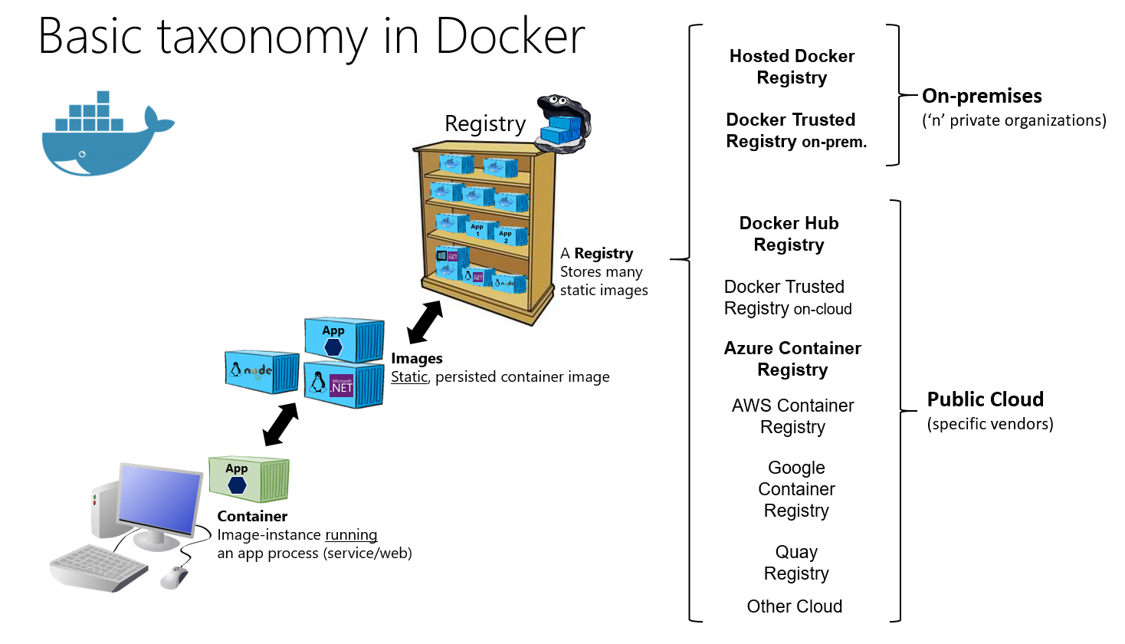

Slide 12
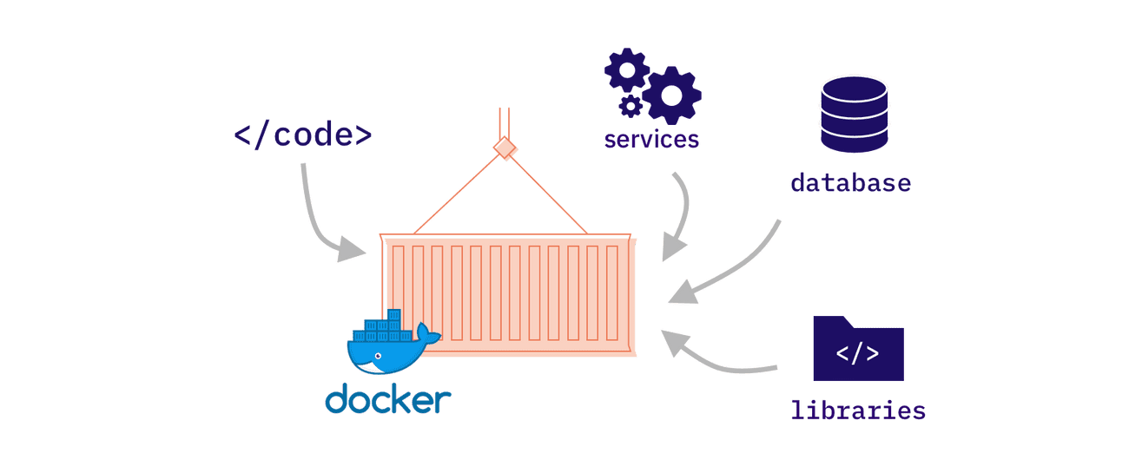
Summary
Docker can reduce the size of development by providing a smaller footprint of the operating system via containers.
With containers, it becomes easier for teams across different units, such as development, QA and Operations to work seamlessly across applications.
You can deploy Docker containers anywhere, on any physical and virtual machines and even on the cloud.
Since Docker containers are lightweight, they are very easily scalable.

Slide 13

This Photo by Unknown Author is licensed under CC BY-NC-ND

Slide 14
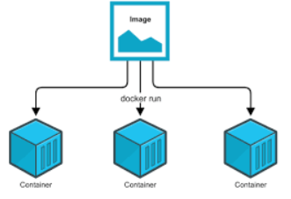
Demo 1- Run a docker image in 3 different containers
1.msdockerapp\..\helloapp. Create docker image and then run the docker image helloapp:latest of the hello world application inside three containers with container port 80 mapped to the host ports 8000, 8001, and 8002. Use 3 different terminals to start the containers and open in browser
$ docker run -p 8000:80 helloapp:latest
$ docker run -p 8001:80 helloapp:latest
$ docker run -p 8002:80 helloapp:latest

Slide 15
Demo 2 – Only authorised user can access a private docker repository and combine two services using docker-compose
2.mslearn-dotnetmicroservices. Create docker images for frontend and backend separately and push it to private repository
$ docker build -t helloworld:frontend .
$ docker tag helloworld:frontend xxx/helloworld:frontend
$ docker push xxx/helloworld:frontend
$ docker build -t helloworld:backend .
$ docker tag helloworld:backend xxx/helloworld:backend
$ docker push xxx/helloworld:backend
$ docker-compose up --build

Slide 16
Demo 2 – Only authorised user can access a private docker repository and combine two services using docker-compose
$ docker-compose up --build
ERROR: The image for the service you're trying to recreate has been removed. If you continue, volume data could be lost. Consider backing up your data before continuing.
Continue with the new image? [yN]y
Pulling backend (xxx/helloworld:backend)...
ERROR: pull access denied for xxx/helloworld, repository does not exist or may require 'docker login': denied: requested access to the resource is denied

Slide 17

Questions
This Photo by Unknown Author is licensed under CC BY-ND

Slide 18
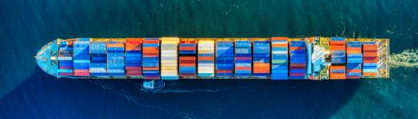
Thank you
This Photo by Unknown Author is licensed under CC BY-SA
Jeya Sundari Asokan

